Slide 1
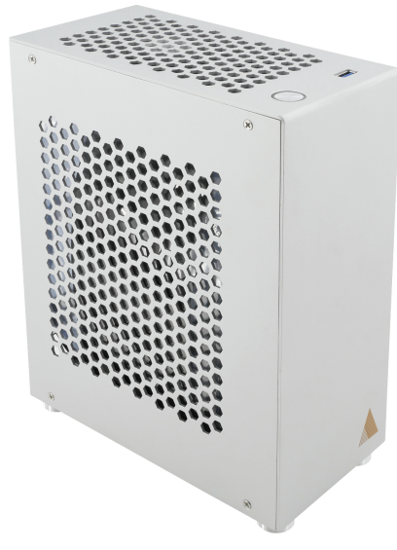
NAME
IMMERSIVE AUDIO CORE ENGINE
MODEL
Traveler Lite Dante
제조사
ADAMSON
IMMERSIVE AUDIO RENDERING ENGINE
Form Factor : Small Form Factor
Audio Interface : Dante™ or AVB / MADI
Sample Rate (kHz) : 44 / 48 / 88 / 96
Latency (ms) : 1.33
Number of Inputs : 32
Number of Outputs : 32
Dimensions (mm) : 102 x 215 x 263
Weight (kg) : 4.5
Reverb Engine
- Number of Engine : 1
- Generator based : ✔
- Convolution based : ✔
- Frontal / Surround / 3D : ✔
Speaker Processing
- Number of Layers : 4
Aux Sends
- Pre / Post Fader Auxiliary Sends : 4
VCA
- VCA Controllers : 8
Remote Control
- FM Remote (Mac, Win) : ✔
- External Protocol : ✔

