Slide 1
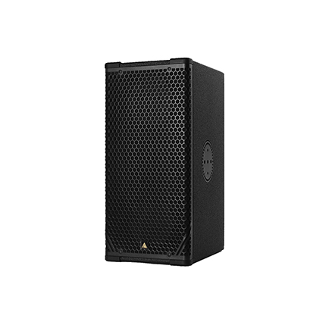
NAME
LINE ARRAY SPEAKER
MODEL
CS7P
제조사
ADAMSON
2-WAY, FULL RANGE INTELLIGENT LOUDSPEAKER
Frequency Range (+/- 3dB) : 80 Hz - 18 kHz
Nominal Directivity (-6 dB) H x V : 70° x 40° or 100° x 50°
Maximum Peak SPL : 136.5 dB
Components LF : 2x ND7-LM16 7” Kevlar Neodymium Driver
Components HF :Adamson NH3 3” Diaphragm / 1.4” Exit Compression Driver
Rigging : Integrated Rigging System
: Built-in Polemount Socket
Connections
Power : powerCON TRUE1
Network : 2 x etherCON
Analog : 2 x XLR
Dimension (WxHxD) : 249/167.6 x 527 x 355.6mm
Weight : 19kg
Amplification : 2 channel Class-D, 2400 W total output
Input Voltage 100 - 240 V
Current Draw at 230 V : 0.45 A rms idle, 1.6 A rms long-term, 9 A max peak
Processing : Onboard / Proprietary

