Slide 1
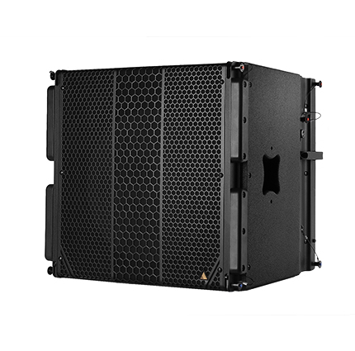
NAME
LINE ARRAY SUBWOOFER SP.
MODEL
CS118
제조사
ADAMSON
SUBWOOFER
Frequency Range (+/- 3dB) : 35 Hz - 100 Hz
Maximum Peak SPL : 133 dB
Components LF : ND18-S 18” Kevlar Neodymium Driver
Rigging : Integrated Rigging System
: Built-in M20 Thread
Connections
Power : powerCON TRUE1
Network : 2 x etherCON
Analog : 2 x XLR
Dimension (WxHxD) : 527 x 508 x 495mm
Weight : 34kg
Amplification : Single channel Class-D, 3000 W total output
Input Voltage : 100 - 240 V
Current Draw at 230 V : 0.45 A rms idle, 1.25 A rms long-term, 11 A max peak
Processing : Onboard / Proprietary

