Slide 1
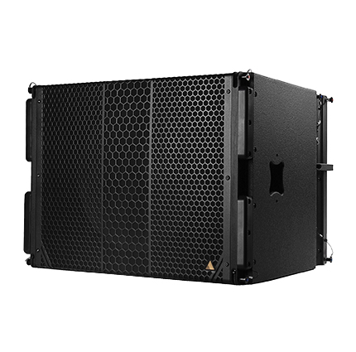
NAME
LINE ARRAY SUBWOOFER SP.
MODEL
CS119
제조사
ADAMSON
SUBWOOFER
Frequency Range (+/- 3dB) : 30 Hz - 100 Hz
Maximum Peak SPL : 138 dB
Components LF : ND19 19” Kevlar Neodymium Driver
Rigging : Integrated Rigging System
: Built-in M20 Thread
Connections
Power : powerCON TRUE1
Network : 2 x etherCON
Analog : 2 x XLR
Dimension (WxHxD) : 742 x 544 x 630mm
Weight : 51kg
Amplification : Single channel Class-D, 3000 W total output
Input Voltage : 100 - 240 V
Current Draw at 230 V : 0.45 A rms idle, 2.15 A rms long-term, 24 A max peak
Processing : Onboard / Proprietary

