Slide 1
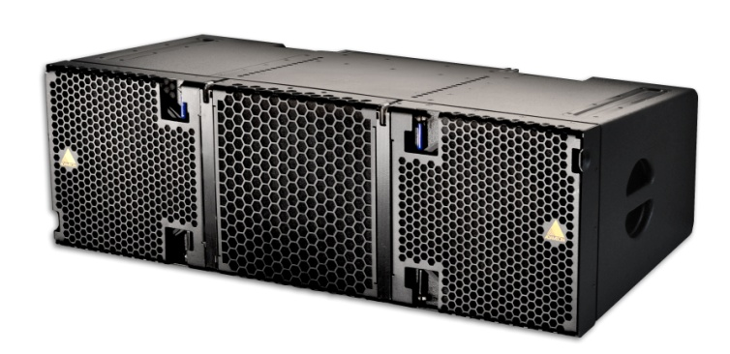
NAME
LINE ARRAY SPEAKER
MODEL
E 12
제조사
ADAMSON
3 WAY LINE ARRAY ENCLOSURE
Frequency Range (+/-3 dB) : 60 Hz - 18 kHz
Nominal Directivity (-6 dB) H x V : 110° x 8°
Maximum Peak SPL : 145 dB
Components LF : 2x ND12-S 12” Kevlar Neodymium Driver
Components MF : YX7 7” Kevlar Neodymium Driver
Components HF : NH4TA2 4” Diaphragm / 1.5” Exit Compression Driver
Nominal Impedance LF : 2x 8 Ω
Nominal Impedance MF : 8 Ω
Nominal Impedance HF : 8 Ω
Power Handling (AES / Peak) LF : 2x 800 / 2x 3200 W
Power Handling (AES / Peak) MF : 350 / 1400 W
Power Handling (AES / Peak) HF : 160 / 640 W
Rigging : Autolock™ Rigging System
Connection : 2x Speakon™ NL8
Dimension (WxHxD) : 1,111 x 358/282 x 543mm
Weight : 59.9kg
Processing : Lake

