Slide 1
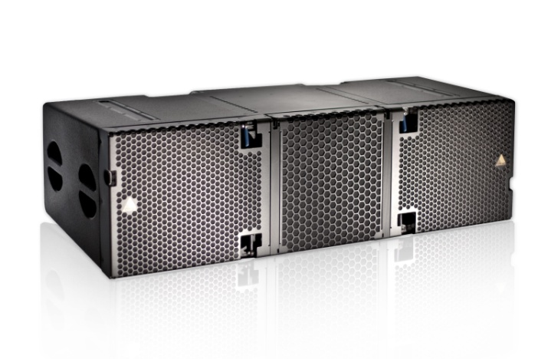
NAME
LINE ARRAY SPEAKER
MODEL
E 15
제조사
ADAMSON
3 WAY LINE ARRAY ENCLOSURE
Frequency Range (+/-3 dB) : 60 Hz - 18 kHz
Nominal Directivity (-6 dB) H x V : 90° x 6°
Maximum Peak SPL : 147 dB
Components LF : 2x ND15-L 15” Kevlar Neodymium Driver
Components MF : 2x YX7 7” Kevlar Neodymium Driver
Components HF : 2x NH4TA2 4” Diaphragm / 1.5” Exit Compression Driver
Nominal Impedance LF : 2x 8 Ω
Nominal Impedance MF : 16 Ω
Nominal Impedance HF : 16 Ω
Power Handling (AES / Peak) LF : 2x 800 / 2x 3200 W
Power Handling (AES / Peak) MF : 700 / 2800 W
Power Handling (AES / Peak) HF : 320 / 1280 W
Rigging : Autolock™ Rigging System
Connection : 2x Speakon™ NL8
Dimension (WxHxD) : 1,306 x 391/333 x 544mm
Weight : 79.8kg
Supported Processing : Lake

