Slide 1
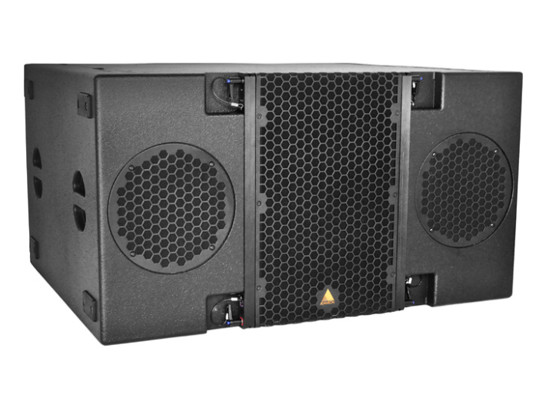
NAME
LINE ARRAY SUBWOOFER SP.
MODEL
E 218
제조사
ADAMSON
SUBWOOFER
Frequency Range (+/- 3dB) : 30 Hz - 110 Hz
Maximum Peak SPL : 142 dB
Components LF : 2x ND18-S 18” Neodymium Kevlar Driver
Nominal Impedance LF : 2x 8 Ω
Power Handling (AES / Peak) LF : 2x 800 / 3200 W
Rigging : Flyable with E-Frame Full Line
Connection : 3x Speakon™ NL8: 2x Rear Parallel (Pins 1 +/-) and 1x Rear Output (Pin 2 to 1)
Dimension (WxHxD) : 1,111 x 597 x 870mm
Weight : 86kg
Supported Processing : Lake

