Slide 1
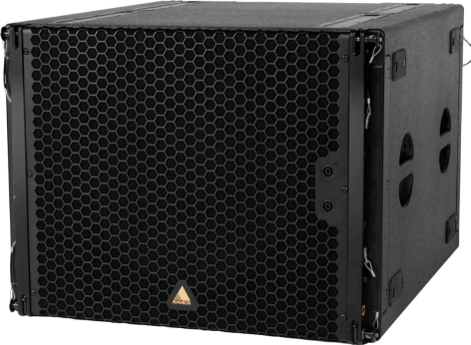
NAME
LINE ARRAY SUBWOOFER SP.
MODEL
E 119
제조사
ADAMSON
SUBWOOFER
Frequency Range (+/- 3dB) : 30 Hz - 100 Hz
Maximum Peak SPL : 138 dB
Components LF : SD19 19” Kevlar Neodymium Driver
Nominal Impedance LF : 8 Ω
Power Handling (AES / Peak) : LF 1600 / 6400 W
Connection : 4x Speakon™ NL4: 2x Rear Parallel (Pins 1 +/-) and 2x Front Cardioid Input (Pin 2 to 1)
Dimension (WxHxD) : 749 x 572 x 889mm
Weight : 66.5kg
Supported Processing : Lake

