Slide 1
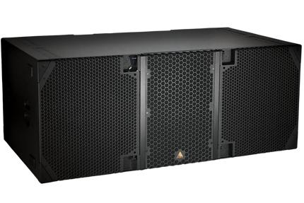
NAME
LINE ARRAY SUBWOOFER SP.
MODEL
E 219
제조사
ADAMSON
SUBWOOFER
Frequency Range (+/- 3dB) : 28 Hz - 90 Hz
Maximum Peak SPL : 144 dB
Components LF : 2x SD19 19” Kevlar Neodymium Driver
Nominal Impedance LF : 2x 8 Ω
Power Handling (AES / Peak) LF : 2x 1600 / 2x 6400 W
Rigging : Integrated Rigging System
Connection : 3x Speakon™ NL8: 2x Rear Parallel (Pins 1 +/-) and 1x Rear Output (Pin 2 to 1)
Dimension (WxHxD) : 1,440 x 597 x 889mm
Weight : 106.6kg
Supported Processing : Lake

