Slide 1
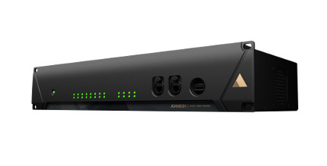
NAME
RACK MOUNT SYSTEM
MODEL
Gateway
제조사
ADAMSON
Connection : 8x XLR in, 8x XLR out, 6x etherCON (3x Prim., 3x Sec.), 2x opticalCON Multi-Mode (1x Prim., 1x Sec.), 2x BNC (Wordclock In/Out), 1x powerCON TRUE1
Height Front (mm / in) : 88 / 3.46
Width (mm / in) : 483 / 19
Depth (mm / in) : 256 / 10.1
Input Voltage : 100 - 240 V
Current Draw at 230 V : 1 A
Internal Sample Rate : 96 kHz / 24 bit

