Slide 1
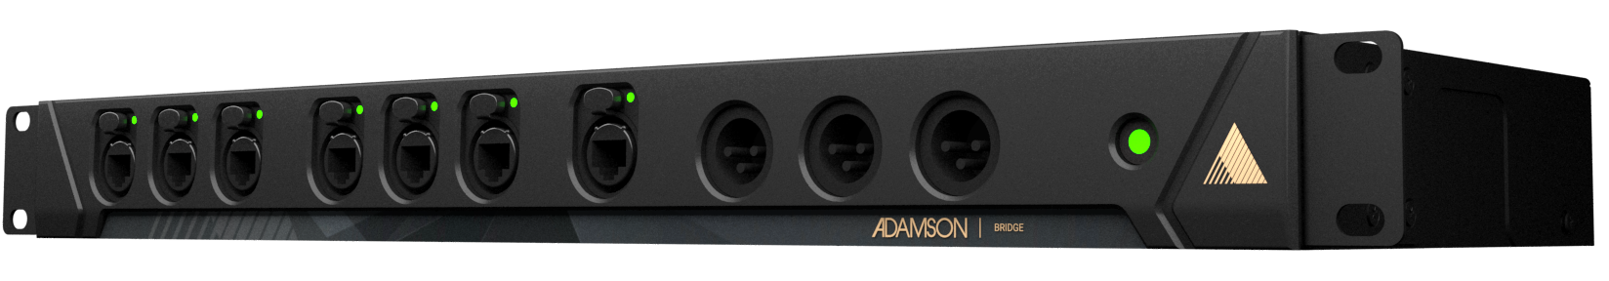
NAME
RACK MOUNT SYSTEM
MODEL
Bridge
제조사
ADAMSON
Connection : 3x XLR out, 7x etherCON (3x Primary, 3x Secondary, 1x Data Out), 1x powerCON TRUE1
Height Front (mm / in) : 88 / 3.46
Width (mm / in) : 483 / 19
Depth (mm / in) : 256 / 10.1
Input Voltage : 100 - 240 V
Internal Sample Rate : 96 kHz / 24 bit

