Slide 1
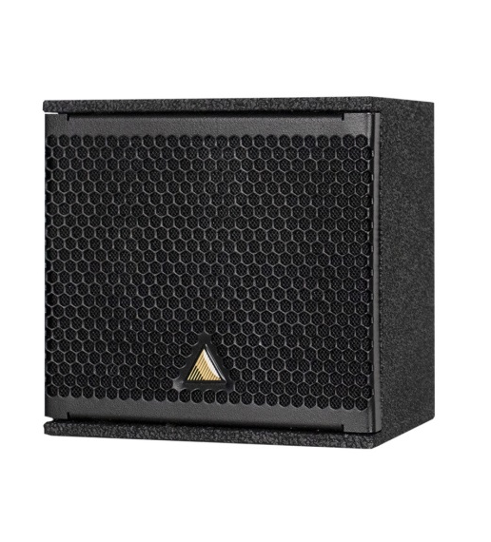
NAME
2WAY COAXIAL SPEAKER
MODEL
IS5C
제조사
ADAMSON
ULTRA-COMPACT, LIGHT-WEIGHT, PASSIVE 2-WAY COAXIAL LOUDSPEAKER
Frequency Range (- 6 dB) : 95 Hz - 20 kHz
Nominal Directivity (-6 dB) H x V : 100° Conical
Maximum Peak SPL : 123 dB
Coaxial Component : 5” LF / 1.4” Dome Compression Driver
Nominal Impedance : 16 Ω
Power Handling (AES / Peak) LF : 125 / 500 W
Rigging : Top and Bottom mini-SLR discs, each
: containing 3/8” threaded insert
Connection : 2x Speakon™ NL4 and 2-Point Barrier Strip
Dimension (WxHxD) : 153/134 x 149 x 134mm
Weight : 2.25kg
Colour : Black & White (Standard), RAL Colours (On Demand)
Processing : Lake

