Slide 1
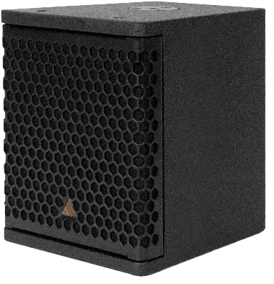
NAME
2WAY COAXIAL SPEAKER
MODEL
IS7C
제조사
ADAMSON
ULTRA-COMPACT, LIGHT-WEIGHT, PASSIVE 2-WAY COAXIAL LOUDSPEAKER
Frequency Range (- 10 dB) : 80 Hz - 20 kHz
Nominal Directivity (-6 dB) H x V : 90° Conical
Maximum Peak SPL : 130 dB
Coaxial Component : 7” LF / 1.7” Dome Compression Driver
Nominal Impedance : 16 Ω
Power Handling (AES / Peak) LF : 300 / 1000 W
Rigging : Top and Bottom mini-SLR discs, each
containing 3/8” threaded insert
Connection : 2x Speakon™ NL4 and 2-Point Barrier Strip
Dimension (WxHxD) : 188/155 x 224.5 x 228mm
Weight : 5.44kg
Colour : Black & White (Standard), RAL Colours (On Demand)
Processing : Lake

