Slide 1
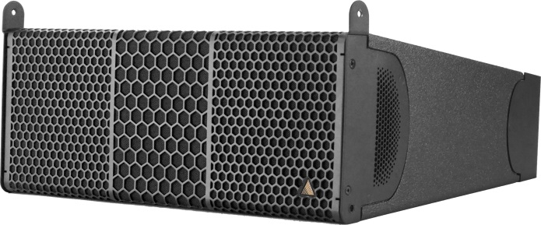
NAME
LINE ARRAY SPEAKER
MODEL
IS7
제조사
ADAMSON
2-WAY FULL RANGE LINE ARRAY CABINET
Frequency Range (+/- 3dB) : 80 Hz - 18 kHz
Nominal Directivity (-6 dB) H x V : 100° x 12.5°
Maximum Peak SPL : 138 dB
Components LF : 2x ND7-LM-8 7” Neodymium Driver
Components HF : Adamson NH3-16 3” Diaphragm / 1.4” Exit Compression Driver
Nominal Impedance LF : 16 Ω (2 x 8 Ω)
Nominal Impedance HF : 16 Ω
Power Handling (AES / Peak) LF : 500 / 2000 W
Power Handling (AES / Peak) HF : 110 / 440 W
Rigging : Integrated Rigging System
Connection : 2x Speakon™ NL4 or Barrier Strips or Cable Gland
Dimension (WxHxD) : 527 x 236/122 x 401mm
Weight : 14kg
Colour : Black & White (Standard), RAL Colours (On Demand)
Processing : Lake

