Slide 1
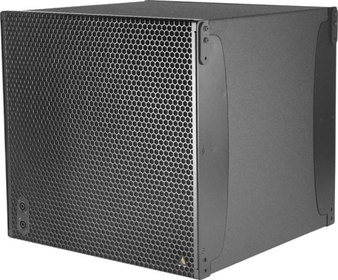
NAME
SUBWOOFER SPEAKER
MODEL
IS118
제조사
ADAMSON
SUBWOOFER
Frequency Range (+/- 3dB) : 35 Hz - 100 Hz
Maximum Peak SPL : 133 dB
Components LF : ND18-S 18” Kevlar Neodymium Driver
Nominal Impedance LF : 8 Ω
Power Handling (AES / Peak) LF : 500 / 2000 W
Rigging : Integrated Rigging System
Connection : 4x Speakon™ NL4 (2x Front 1+/1-, 2x Rear (2+/2-) or Barrier Strips or Cable Gland
Dimension (WxHxD) : 527 x 507 x 529mm
Weight : 30kg
Colour : Black & White (Standard), RAL Colours (On Demand)
Supported Processing : Lake

