Slide 1
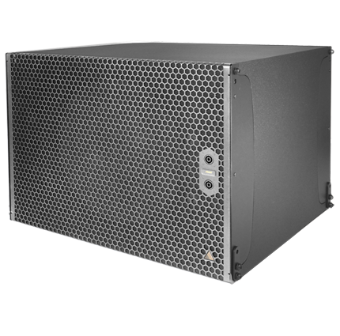
NAME
SUBWOOFER SPEAKER
MODEL
IS119
제조사
ADAMSON
Subwoofer
Frequency Range (+/- 3dB) : 30 Hz - 100 Hz
Maximum Peak SPL : 138 dB
Components LF : ND19 19” Kevlar Neodymium Driver
Nominal Impedance LF : 8 Ω
Power Handling (AES / Peak) LF : 1200 / 4800 W
Rigging : Integrated Rigging System
Connection : 4x Speakon™ NL4 (2x Front 1+/1-, 2x Rear (2+/2-), or Barrier Strips or Cable Gland
Dimension (WxHxD) : 737 x 544 x 645mm
Weight : 46.5kg
Colour : Black & White (Standard), RAL Colours (On Demand)
Supported Processing : Lake

