Slide 1
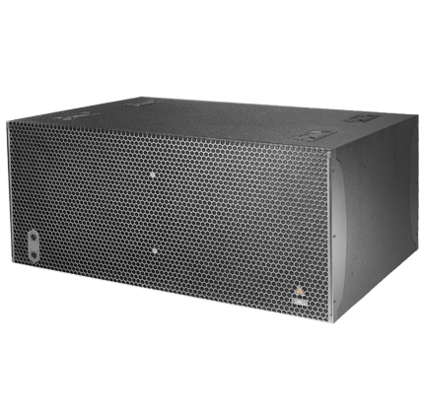
NAME
SUBWOOFER SPEAKER
MODEL
IS219
제조사
ADAMSON
Subwoofer
Frequency Range (+/- 3dB) : 29 Hz - 100 Hz
Maximum Peak SPL : 143 dB
Components LF : 2x SD19 19” Kevlar Neodymium Driver
Nominal Impedance LF : 4 Ω (2x 8 Ω)
Power Handling (AES / Peak) LF : 3200 / 12800 W
Rigging : N/A
Connection : 4x Speakon™ NL4 (2x Front 1+/1-, 2x Rear (2+/2-) or Barrier Strips or Cable Gland
Dimension (WxHxD) : 1,168 x 508 x 875mm
Weight : 90kg
Supported Processing : Lake

