Slide 1
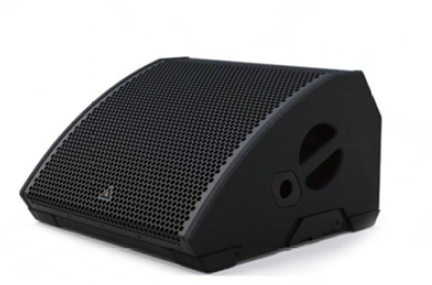
NAME
STAGE MONITOR SPEAKER
MODEL
M10
제조사
ADAMSON
STAGE MONITOR SPEAKER
Frequency Range (+/- 3dB) : 60 Hz - 20 kHz
Nominal Directivity (-6dB) H x V : 50° x 100°
Maximum Peak SPL : 139 dB
Components LF : 2x ND10-LM 10” Kevlar Neodymium Driver
Components HF : NH3 3” Diaphragm / 1.4” Exit Compression Driver
Nominal Impedance LF : 8 Ω
Nominal Impedance HF : 8 Ω
Power Handling (AES / Peak) LF : 700 / 2800 W
Power Handling (AES / Peak) HF : 120 / 480 W
Rigging : Integrated Pole Mount
Connection : 2x Speakon NL4
Dimension (WxHxD) : 520 x 324 x 540mm
Weight : 22kg
Processing : Lake

