Slide 1
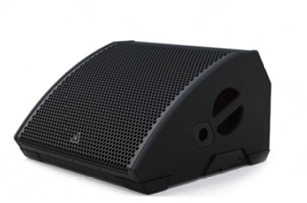
NAME
STAGE MONITOR SPEAKER
MODEL
MG10
제조사
ADAMSON
STAGE MONITOR SPEAKER
Frequency Range (+/- 3dB) : 60 Hz - 20 kHz
Nominal Directivity (-6dB) H x V : 50° x 100°
Maximum Peak SPL : 139 dB
Components LF : 2x ND10-LM 10” Kevlar Neodymium Driver
Components HF : NH3 3” Diaphragm / 1.4” Exit Compression Driver
Rigging : Integrated Pole Mount
Connection
- Power : powerCON TRUE1
- Network : 2x etherCON
- Analog : 2x XLR
Dimension (WxHxD) : 520 x 324 x 540mm
Weight : 26kg
Amplification : 2 channel Class-D, 2400 W total output
Input Voltage : 100 - 240 V
Current Draw : 230 V 0.45 A rms idle, 1.6 A rms long-term, 10 A maxpeak
Processing : Onboard / Proprietary

