Slide 1
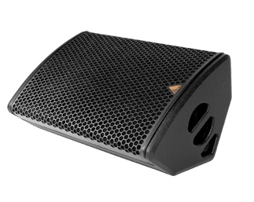
NAME
STAGE MONITOR SPEAKER
MODEL
M12-A/P
제조사
ADAMSON
STAGE MONITOR SPEAKER
Frequency Range (+/- 3dB) : 60 Hz - 18 kHz
Nominal Directivity (-6dB) H x V : 65° x 65°
Maximum Peak SPL (Active / Passive) : 136.9 dB / 136.7 dB
Components LF : 12” ND12-L Kevlar Neodymium Mid-Bass Driver
Components HF : B&C DE920TN 3” Diaphragm / 1.4” Exit Compression Driver
Nominal Impedance LF : 8 Ω
Nominal Impedance HF : 8 Ω
Nominal Impedance Passive : 8 Ω
Power Handling (AES / Peak) LF : 500 / 2000 W
Power Handling (AES / Peak) HF : 110 / 440 W
Power Handling (AES / Peak) Passive : 610 / 2440 W
Connection : 4x Speakon™ NL4
Dimension (WxHxD) : 638 x 343 x 401mm
Weight : 19.3kg
Processing : Lake, XTA

