Slide 1
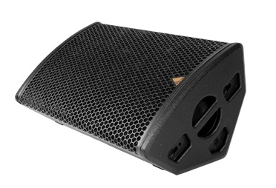
NAME
STAGE MONITOR SPEAKER
MODEL
M15-A/P
제조사
ADAMSON
MULTI-PURPOSE LOUDSPEAKER
Frequency Range (+/- 3dB) : 50 Hz - 18 kHz
Nominal Directivity (-6dB) H x V : 50° x 50°
Maximum Peak SPL (Active / Passive) : 137.8 dB / 137.3 dB
Components LF : ND15-L 15” Kevlar Neodymium Driver
Components HF : B&C DE1000 4” Diaphragm / 1.5” Exit Compression Driver
Nominal Impedance LF : 8 Ω
Nominal Impedance HF : 8 Ω
Nominal Impedance Passive : 8 Ω
Power Handling (AES / Peak) LF : 500 / 2000 W
Power Handling (AES / Peak) HF : 140 / 560 W
Power Handling (AES / Peak) Passive : 640 / 2560 W
Connection : 4x Speakon™ NL4
Dimension (WxHxD) : 724 x 356 x 429mm
Weight : 25.63kg
Processing : Lake, XTA

