Slide 1
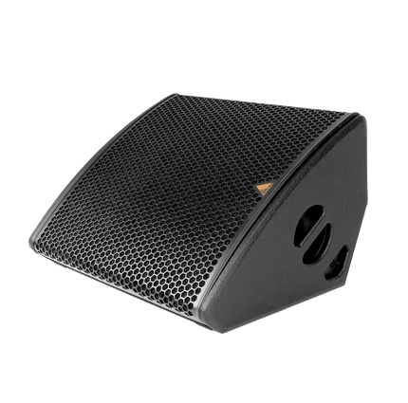
NAME
STAGE MONITOR SPEAKER
MODEL
M212-A
제조사
ADAMSON
STAGE MONITOR SPEAKER
Frequency Range (+/- 3dB) : 50 Hz - 18 kHz
Nominal Directivity (-6dB) H x V : 65° x 65°
Maximum Peak SPL : 142.5 dB
Components LF : 2x 12” ND12-L Kevlar Neodymium Mid-Bass Driver
Components HF : B&C DE920TN 3” Diaphragm / 1.4” Exit Compression Driver
Nominal Impedance LF : 4 Ω
Nominal Impedance HF : 8 Ω
Power Handling (AES / Peak) LF : 2x 500 / 2x 2000 W
Power Handling (AES / Peak) HF : 110 / 440 W
Connection : 4x Speakon™ NL4
Dimension (WxHxD) : 630 x 401 x 584mm
Weight : 32.65kg
Processing : Lake, XTA

