Slide 1
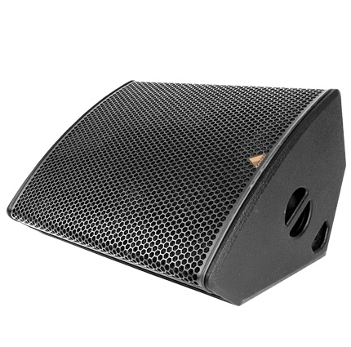
NAME
STAGE MONITOR SPEAKER
MODEL
M215-A
제조사
ADAMSON
STAGE MONITOR SPEAKER
Frequency Range (+/- 3dB) : 45 Hz - 18 kHz
Nominal Directivity (-6dB) H x V : 50° x 50°
Maximum Peak SPL : 143.7 dB
Components LF : 2x ND15-L 15” Kevlar Neodymium Driver
Components HF : B&C DE1000 4” Diaphragm / 1.5” Exit Compression Driver
Nominal Impedance LF : 4 Ω
Nominal Impedance HF : 8 Ω
Power Handling (AES / Peak) LF : 2x 500 / 2x 2000 W
Power Handling (AES / Peak) HF : 140 / 560 W
Connection : 4x Speakon™ NL4
Dimension (WxHxD) : 818 x 470 x 605mm
Weight : 41.6kg
Processing : Lake, XTA

