Slide 1
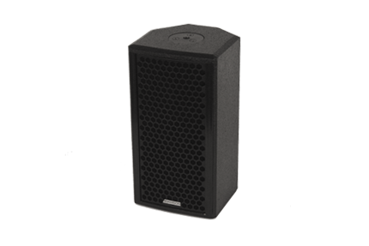
NAME
SPEAKER
MODEL
POINT CONCENTRIC 5
제조사
ADAMSON
PASSIVE 2-WAY COAXIAL LOUDSPEAKER
Frequency Range (-10 dB) : 72 Hz - 18 kHz
Nominal Directivity (-6 dB) H x V : 70° x 70°
Maximum Peak SPL : 128 dB
Components LF : B&C ALT0050158 5” Driver
Components MF / HF : B&C 5FCX44 5” Coaxial Driver
Nominal Impedance Passive : 4 Ω
Power Handling (AES / Peak) LF : 100 / 400 W
Power Handling (AES / Peak) MF : 100 / 400 W
Power Handling (AES / Peak) HF : 10 / 40 W
Power Handling (AES / Peak) Passive : 210 / 840 W
Rigging : 2x Mini SLR™ Socket (M10)
: Omni Mount 20 Series with 1/4 - 20 Screws
Connection : 2x Speakon™ NL4
Dimension (WxHxD) : 171 x 321 x 172mm
Weight : 5.9kg
Processing : Lake, IPD

