Slide 1
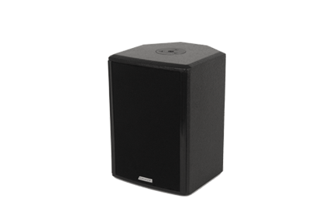
NAME
SPEAKER
MODEL
POINT CONCENTRIC 6
제조사
ADAMSON
COAXIAL LOUDSPEAKER
Frequency Range (-10 dB) : 82 Hz - 18 kHz
Nominal Directivity (-6 dB) H x V : 70° x 70°
Maximum Peak SPL : 125 dB
Components LMF / HF : B&C 6FHX51 6.5” Coaxial Driver
Nominal Impedance Passive : 6 Ω
Power Handling (AES / Peak) LF : 150 / 600 W
Power Handling (AES / Peak) HF : 10 / 40 W
Power Handling (AES / Peak) Passive : 160 / 640 W
Rigging : 2x Mini SLR™ Socket (M10)
: Omni Mount 20 Series with 1/4 - 20 Screws
Connection : 2x Speakon™ NL4
Dimension (WxHxD) : 201 x 280 x 209mm
Weight : 5.5kg
Processing : Lake, IPD

