Slide 1
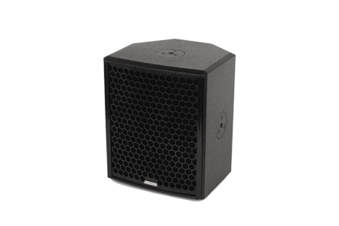
NAME
SPEAKER
MODEL
POINT CONCENTRIC 8
제조사
ADAMSON
COAXIAL LOUDSPEAKER
Frequency Range (-10 dB) : 76 Hz - 18 kHz
Nominal Directivity (-6 dB) H x V : 100° x 100°
Maximum Peak SPL : 131 dB
Components LMF / HF : B&C 8FCX51 8” Coaxial Driver
Nominal Impedance Passive : 4 Ω
Power Handling (AES / Peak) LF : 250 / 1000 W
Power Handling (AES / Peak) HF : 50 / 200 W
Power Handling (AES / Peak) Passive : 300 / 1200 W
Rigging : 3x Mini SLR™ Socket (M10) : Omni Mount 30 Series with 1/4 - 20 Screws : Built-in Polemount Socket
Connection : 2x Speakon™ NL4 (Reversible)
Dimension (WxHxD) : 267 x 316 x 241mm
Weight : 9.5kg
Processing : Lake, IPD

