Slide 1
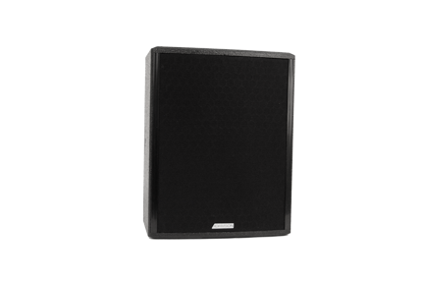
NAME
SPEAKER
MODEL
POINT CONCENTRIC 10
제조사
ADAMSON
COAXIAL LOUDSPEAKER
Frequency Range (-10 dB) : 73 Hz - 18 kHz
Nominal Directivity (-6 dB) H x V : 70° x 70°
Maximum Peak SPL : 132 dB
Components LMF / HF : B&C 10FCX64 10” Coaxial Driver
Nominal Impedance Passive : 4 Ω
Power Handling (AES / Peak) LF : 250 / 1000 W
Power Handling (AES / Peak) HF : 80 / 320 W
Power Handling (AES / Peak) Passive : 330 / 1320 W
Rigging : 3x Mini SLR™ Socket (M10), Omni Mount 30 : Series with 1/4 - 20 Screws, Built-in Polemount Socket
Connection : 2x Speakon™ NL4
Dimension (WxHxD) : 302 x 387 x 292mm
Weight : 11.4kg
Processing : Lake, IPD

