Slide 1
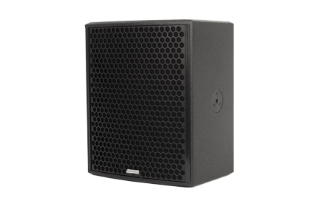
NAME
SPEAKER
MODEL
POINT CONCENTRIC 12
제조사
ADAMSON
COAXIAL LOUDSPEAKER
Frequency Range (-10 dB) : 64 Hz - 18 kHz
Nominal Directivity (-6 dB) H x V : 60° x 40°
Maximum Peak SPL : 133 dB
Components LMF / HF : B&C 12FHX76 12” Coaxial Driver
Nominal Impedance Passive : 4 Ω
Power Handling (AES / Peak) LF : 350 / 1400 W
Power Handling (AES / Peak) HF : 80 / 320 W
Power Handling (AES / Peak) Passive : 430 / 1720 W
Rigging : 3x Mini SLR™ Socket (M10), Built-in Polemount Socket
Connection : 2x Speakon™ NL4
Dimension (WxHxD) : 353 x 436 x 329mm
Weight : 15.4kg
Processing : Lake, IPD

