Slide 1
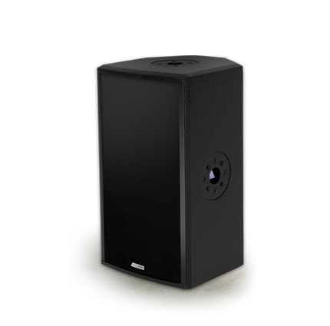
NAME
SPEAKER
MODEL
POINT 8P
제조사
ADAMSON
2 WAY PASSIVE SPEAKER
Frequency Range (+/- 3dB) : 65 Hz - 20 kHz
Nominal Directivity (-6dB) H x V : 90° x 60° Rotatable
Maximum Peak SPL : 130.6 dB
Components LF : ND8-LM 8” Kevlar Neodymium Driver
Components HF : B&C DE500 1.7” Diaphragm / 1” Exit Compression Driver
Nominal Impedance Passive : 8 Ω
Power Handling (AES / Peak) : 300 / 1200 W
Rigging : 4x SLR™ Socket, Omni Mount 30 Series, Built-in
Polemount Socket
Connection : 2x Speakon™ NL4 (Barrier Strip Optional)
Dimension (WxHxD) : 251 x 451 x 251mm
Weight : 12.5kg
Processing : Lake, IPD, XTA

