Slide 1
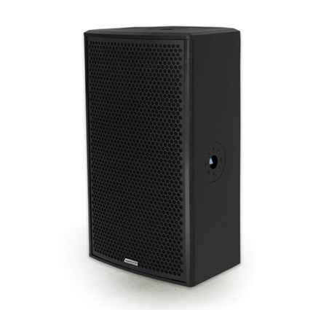
NAME
SPEAKER
MODEL
POINT 12/P
제조사
ADAMSON
2 WAY PASSIVE SPEAKER
Frequency Range (+/- 3dB) : 60 Hz - 18 kHz
Nominal Directivity (-6dB) H x V : 90° x 60° Rotatable
Maximum Peak SPL : 132.5 dB
Components LF : ND12-L Kevlar Neodymium Driver
Components HF : B&C DE800 3” Diaphragm / 1.4” Exit Compression Driver
Nominal Impedance : 8 Ω
Power Handling (AES / Peak) : 610 / 2440 W
Rigging : 4x SLR™ Socket, Built-in Polemount Socket
Connection : 2x Speakon™ NL4 (Barrier Strip Optional)
Dimension (WxHxD) : 353 x 642 x 310mm
Weight : 22.5kg
Processing : Lake, IPD, XTA

