Slide 1
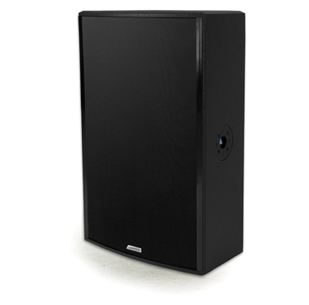
NAME
SPEAKER
MODEL
POINT 15/A
제조사
ADAMSON
2 WAY BI-AMP SPEAKER
Frequency Range (+/- 3dB) : 55 Hz - 18 kHz
Nominal Directivity (-6dB) H x V : 90° x 60° Rotatable
Maximum Peak SPL : 136 dB
Components LF : ND15-L Kevlar Neodymium Driver
Components HF : B&C DE800 3” Diaphragm / 1.4” Exit Compression Driver
Nominal Impedance LF : 8 Ω
Nominal Impedance HF : 16 Ω
Power Handling (AES / Peak) LF : 500 / 2000 W
Power Handling (AES / Peak) HF : 110 / 440 W
Rigging : 4x SLR™ Socket, Built-in Polemount Socket
Connection : 2x Speakon™ NL4 (Barrier Strip Optional)
Dimension (WxHxD) : 451 x 726 x 334mm
Weight : 24.8kg
Processing : Lake, IPD, XTA

