Slide 1
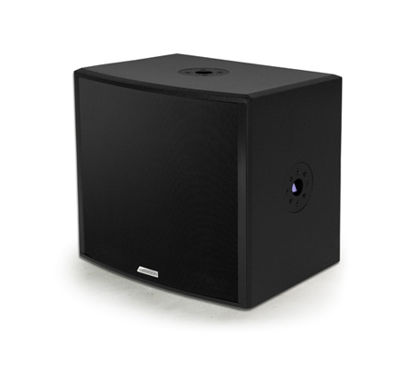
NAME
SUB WOOFER SPEAKER
MODEL
POINT115SUB/A
제조사
ADAMSON
SUBWOOFER
Frequency Range (+/- 3dB) : 55Hz - 200Hz
Components LF : ND15-S 15” Kevlar Neodymium Driver
Nominal Impedance LF : 8 Ω
Power Handling (AES / Peak) LF : 500 / 2000 W
Rigging : SLR™ Sockets, OmniMount 60 Series
Connection : 2x Speakon™ NL4 (Barrier Strip Optional)
Dimension (WxHxD) : 451 x 419 x 334mm
Weight : 17.5kg
Supported Processing : Lake, IPD, XTA

