Slide 1
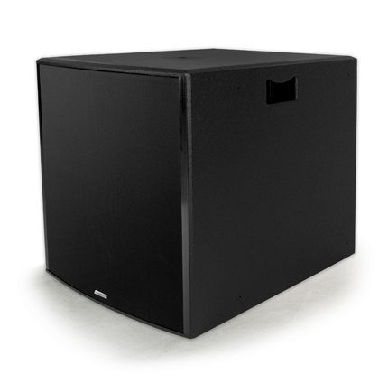
NAME
SUB WOOFER SPEAKER
MODEL
POINT215SUB
제조사
ADAMSON
SUBWOOFER
Frequency Range (+/- 3dB) : 40Hz - 160Hz
Maximum Peak SPL : 136.3 dB
Components LF : 2x ND15-S 15” Kevlar Neodymium Driver
Nominal Impedance LF : 4 Ω
Power Handling (AES / Peak) LF : 2x 500 / 2x 2000 W
Rigging : Built-in M20 Thread, 5/16-18 Threads for Eye-hooks
Connection : 2x Speakon™ NL4 (Barrier Strip Optional)
Dimension (WxHxD) : 540 x 619 x 757mm
Weight : 47kg
Supported Processing : Lake, XTA

