Slide 1
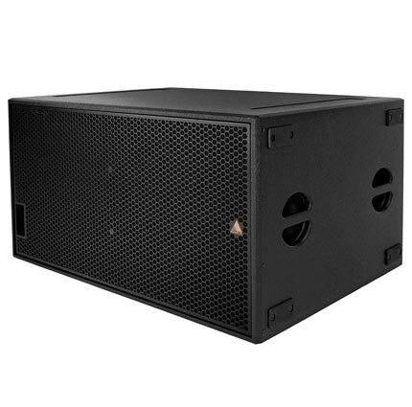
NAME
SUBWOOFER SPEAKER
MODEL
A 218
제조사
ADAMSON
SUBWOOFER
Frequency Range (+/- 3dB) : 40Hz - 160Hz
Maximum Peak SPL : 138.4 dB
Components LF : 2x ND18-S 18” Kevlar Neodymium Drivers
Nominal Impedance LF : 4.5 Ω
Power Handling (AES / Peak) LF : 2x 800 / 2x 3200 W
Connection : 4x Neutrik Speakon™ NL4: 2x Front (Pins 2+/-), 2x Rear (Pins 1 +/-)
Dimension (WxHxD) : 1,066 x 584 x 825mm
Weight : 65kg
Supported Processing : Lake

