Slide 1
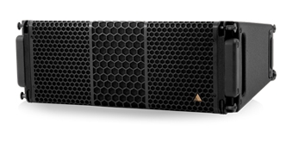
NAME
LINE ARRAY SPEAKER
MODEL
S7
제조사
ADAMSON
2-WAY, FULL RANGE LINE ARRAY CABINET
Frequency Range (+/- 3dB) : 80 Hz - 18 kHz
Nominal Directivity (-6 dB) H x V : 100° x 12.5°
Maximum Peak SPL : 138 dB
Components LF : 2x ND7-LM16 7” Kevlar Neodymium Driver
Components HF : Adamson NH3-8 3” Diaphragm / 1.4” Exit Compression Driver
Nominal Impedance LF : 2 x 16 Ω (8 Ω)
Nominal Impedance HF : 8 Ω
Power Handling (AES / Peak) LF : 500 / 2000 W
Power Handling (AES / Peak) HF : 110 / 440 W
Rigging : SlideLock Rigging System
Connection : 2x Speakon™ NL4
Dimension (WxHxD) : 527 x 203/122 x 411mm
Weight : 15kg
Processing : Lake

