Slide 1
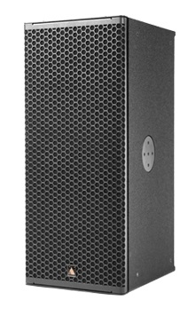
NAME
POINT SOURCE SPEAKER
MODEL
IS10p
제조사
ADAMSON
2-WAY FULL RANGE POINT SOURCE CABINET
Frequency Range (+/- 3dB) : 60 Hz - 18 kHz
Nominal Directivity (-6 dB) H x V : 70° x 40° or 100° x 50° Rotatable
Maximum Peak SPL : 139 dB
Components LF : 2x ND10-LM 10” Kevlar Neodymium Driver
Components HF : Adamson NH3-8 3” Diaphragm / 1.4” Exit Compression Driver
Nominal Impedance LF : 8 Ω (2x 16 Ω)
Nominal Impedance HF : 8 Ω
Power Handling (AES / Peak) LF : 700 / 2800 W
Power Handling (AES / Peak) HF : 110 / 440 W
Rigging : Integrated Rigging System
Connection : 2x Speakon™ NL4 or Barrier Strips or Cable Gland
Dimension (WxHxD) : 326.4/203 x 737 x 442mm
Weight : 25kg
Colour : Black & White (Standard), RAL Colours (On Demand)
Processing : Lake

