Slide 1
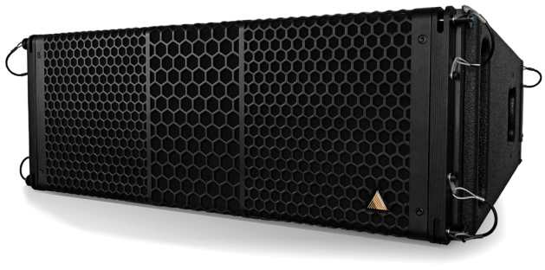
NAME
LINE ARRAY SPEAKER
MODEL
S10
제조사
ADAMSON
2-WAY, FULL RANGE LINE ARRAY CABINET
Frequency Range (+/- 3dB) : 60 Hz - 18 kHz
Nominal Directivity (-6 dB) H x V : 110° x 10°
Maximum Peak SPL : 141.3 dB
Components LF : 2x ND10-LM 10” Kevlar Neodymium Driver
Components HF : Adamson NH4TA2 4” Diaphragm / 1.5” Exit Compression Driver
Nominal Impedance LF : 2 x 16 Ω (8 Ω)
Nominal Impedance HF : 8 Ω
Power Handling (AES / Peak) LF : 700 / 2800 W
Power Handling (AES / Peak) HF : 160 / 640 W
Rigging : SlideLock Rigging System
Connection : 2x Speakon™ NL8
Dimension (WxHxD) : 737 x 265/178 x 526mm
Weight : 27kg
Processing : Lake

