Slide 1
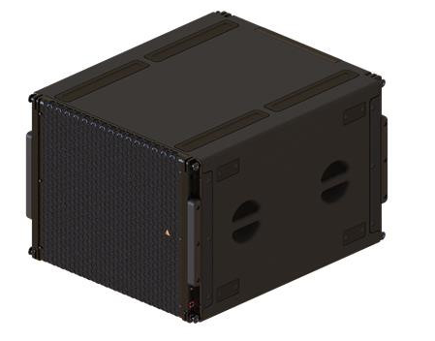
NAME
SUBWOOFER
MODEL
VGs
제조사
ADAMSON
POWERD SUBWOOFER
Frequency Range (+/-3 dB) : 29 Hz - 100 Hz
Maximum Peak SPL** : 139 dB
Components LF : SD19 19" Kevlar® Neodymium Driver
Rigging : Integrated Rigging System
Connection : 2x etherCON™ - passive continuity when powerless, Analog XLR3 in & thru, powerCON TRUE1 TOP in & thru
Height Front (mm / in) : 572 / 22.5
Width (mm / in) : 749 / 29.5
Depth (mm / in) : 889 / 35
Weight (kg / lbs) : 72.5 / 160
Amplification : Single-Channel Class-D, 6000 W total output
Input Voltage : 100 - 240 V
Supported Processing : Onboard / Proprietary

