Slide 1
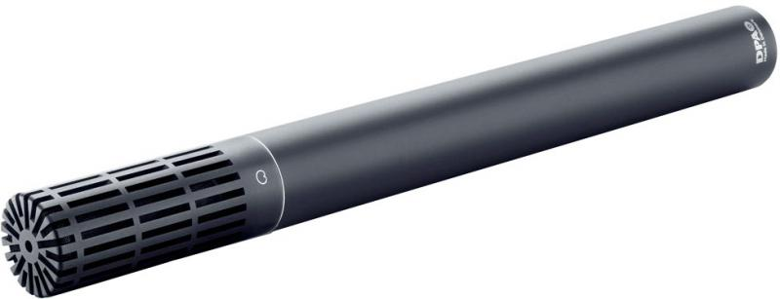
NAME
MICROPHONE
MODEL
2011A
제조사
DPA
Cardioid Microphone
Directional pattern : Cardioid
Principle of operation : Pressure gradient, with interference tube
Cartridge type : Pre-polarized condenser, Twin Diaphragm Capsule
Frequency range : 20 Hz - 20 kHz
Sensitivity, nominal, ±2 dB at 1 kHz : 10 mV/Pa; -40 dB re. 1 V/Pa
Switchable attenuator : 0 dB / -20 dB
Output impedance : < 200 Ω
Output balance principle : Impedance balancing with Active Drive
Common Mode Rejection Ratio (CMRR) : > 60 dB
Power supply : 48 V Phantom power (±4 V for full specifications)
Current consumption : 2.8 mA
Polarity : +V at Pin 2 for positive sound pressure
Connector : XLR-3M. Pin 1: shield, Pin 2: signal + phase, Pin 3: - phase
Weight : 160 g (5.6 oz)

