Slide 1
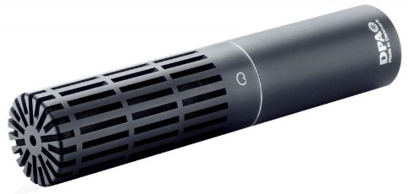
NAME
MICROPHONE
MODEL
2011C
제조사
DPA
Cardioid Microphone
Directional pattern : Cardioid
Principle of operation : Pressure gradient, with interference tube
Cartridge type : Pre-polarized condenser, Twin Diaphragm Capsule
Frequency response : 20 Hz - 20 kHz
Sensitivity, nominal, ±2 dB at 1 kHz : 10 mV/Pa; -40 dB re. 1 V/Pa
Rated output impedance : 100 Ω
Output balance principle : Impedance balancing with Active Drive
Common mode rejection ratio (CMRR) : > 50 dB
Power supply (for full performance) : P48 (Phantom Power)
Current consumption : 2.8 mA
Polarity : +V at pin 2 for positive sound pressure
Connector : XLR-3M. Pin 1: shield, Pin 2: signal + phase, Pin 3: - phase
Weight : 64 g (2.3 oz)

