Slide 1
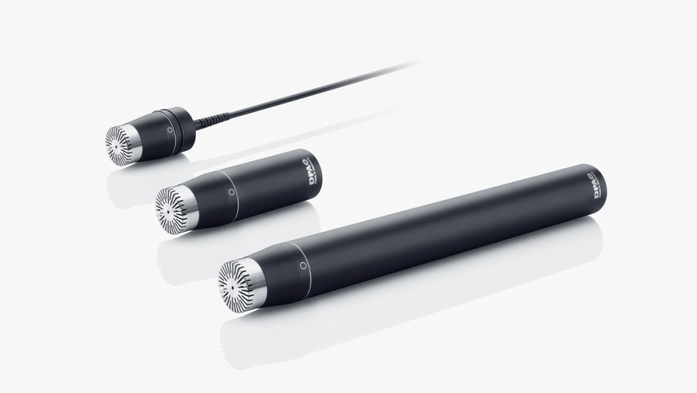
NAME
SUSPENSION MICROPHONE
MODEL
4006
제조사
DPA
Omnidirectional Microphone
Directional pattern : Omnidirectional
Principle of operation : Pressure
Cartridge type : Pre-polarized condenser
Frequency response : 10 Hz - 20 kHz
Effective frequency range ±2 dB : 10 Hz - 20 kHz
Sensitivity, nominal, ±2 dB at 250 Hz : 40 mV/Pa; -28 dB re. 1 V/Pa
Distortion, THD < 1% : 136 dB SPL RMS, 139 dB SPL peak
Dynamic range : Typ. 124 dB
Max. SPL, THD 10% : 146 dB SPL peak
Switchable attenuator, filters etc. : 0 dB / -20 dB
Rated output impedance : 200 Ω
Minimum load impedance : 2 kΩ
Common mode rejection ratio (CMRR) : > 60 dB
Connector : XLR-3M. Pin 1: shield, Pin 2: signal + phase, Pin 3: - phase
Color : Matte black
Weight : 163 g (5.7 oz)
Microphone diameter : 16 - 19 mm (0.6 - 0.75 in)
Capsule diameter : 16 mm (0.6 in)
Microphone length : 170 mm (6.7 in)

