Slide 1
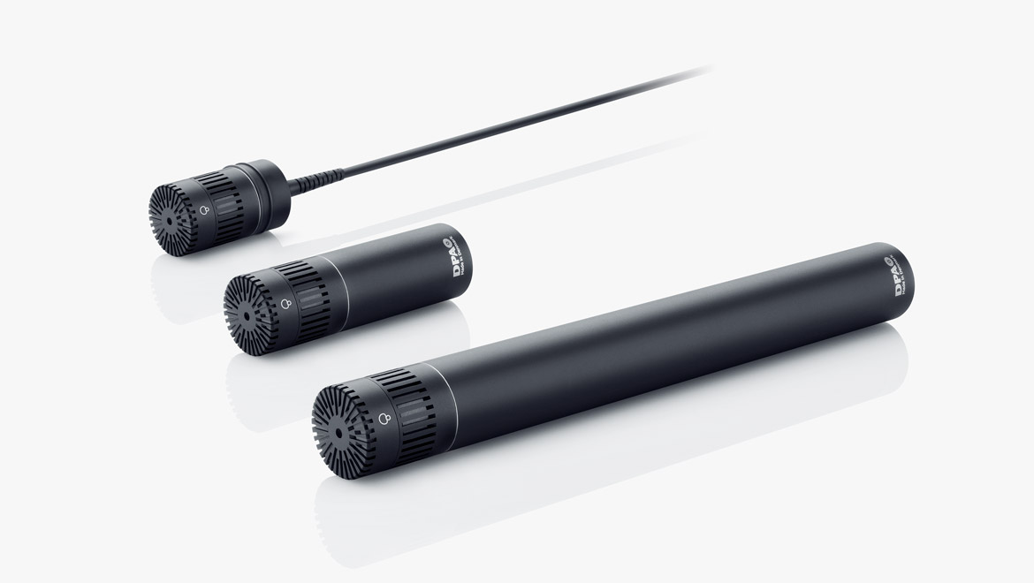
NAME
SUSPENSION MICROPHONE
MODEL
4015
제조사
DPA
Wide Cardioid Microphone
Directional pattern : Wide cardioid
Principle of operation : Pressure gradient
Cartridge type : Pre-polarized condenser
Frequency response : 20 Hz - 20 kHz
Effective frequency range, ±2 dB, at 60 cm (23.6 in) : 40 Hz - 20 kHz
Sensitivity, nominal, ±2 dB at 1 kHz : 10 mV/Pa; -40 dB re. 1 V/Pa
Distortion, THD < 1% : 136 dB SPL RMS, 139 dB SPL peak
Dynamic range : Typ. 121 dB
Max. SPL, THD 10% : 159 dB SPL peak
Switchable attenuator, filters etc. : 0 dB / -20 dB
Rated output impedance : 200 Ω
Minimum load impedance : 2 kΩ
Common mode rejection ratio (CMRR) : > 60 dB
Connector : XLR-3M. Pin 1: shield, Pin 2: signal + phase, Pin 3: - phase
Color : Matte black
Weight : 158 g (5.6 oz)
Microphone diameter : 19 mm (0.75 in)
Capsule diameter : 19 mm (0.75 in)
Microphone length : 170 mm (6.7 in)

