Slide 1
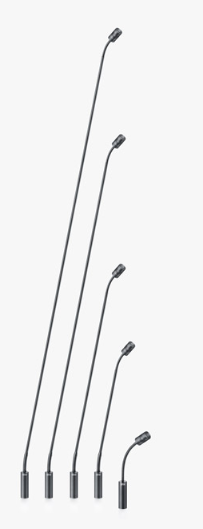
NAME
GOOSENECK MICROPHONE
MODEL
4018
제조사
DPA
Gooseneck Microphone
Directional pattern : Supercardioid
Principle of operation : Pressure gradient
Cartridge type : Pre-polarized condenser
Frequency response : 20 Hz - 20 kHz
Effective frequency range, ±2 dB, at 30 cm (11.8 in) : 40 Hz - 18 kHz
Sensitivity, nominal, ±2 dB at 1 kHz : 12 mV/Pa; -38.4 dB re. 1 V/Pa
Distortion, THD < 1% : 134 dB SPL RMS, 137 dB SPL peak
Dynamic range : Typ. 121 dB
Max. SPL, THD 10% : 142 dB SPL peak
Rated output impedance : 100 Ω
Minimum load impedance : 2 kΩ
Connector : XLR-3M. Pin 1: shield, Pin 2: signal + phase, Pin 3: - phase
Color : Matte black
Microphone diameter : 19 mm (0.75 in)
Capsule diameter : 19 mm (0.75 in)
Microphone length
Capsule : 23 mm (0.9 in),
Boom poles : 20 cm (8 in), 32 cm (13 in), 47 cm (18 in), 77 cm (30 in), 122 cm (48 in)

