Slide 1
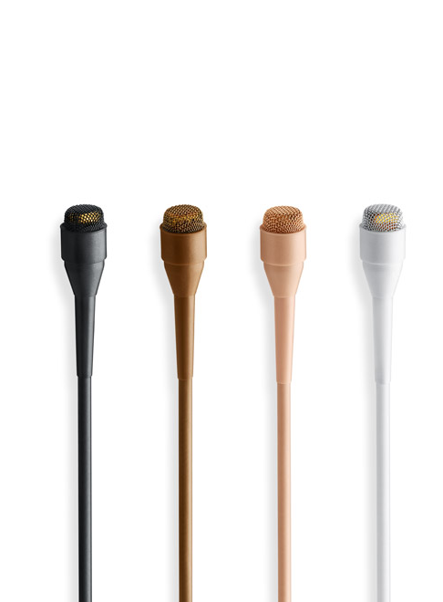
NAME
PIN MICROPHONE
MODEL
4060
제조사
DPA
Miniature Omnidirectional Microphone
Directional pattern : Omnidirectional
Principle of operation : Pressure
Cartridge type : Pre-polarized condenser
Frequency response : 20 Hz - 20 kHz
Effective frequency range ±2 dB
Soft boost grid : 20 Hz - 20 kHz, 3 dB soft boost at 8 – 20kHz.
High boost grid : 20 Hz - 20 kHz, 10 dB boost at 12 kHz
Sensitivity, nominal, ±3 dB at 1 kHz : 20 mV/Pa; -34 dB re. 1 V/Pa
Distortion, THD < 1% - CORE : 126 dB SPL RMS, 129 dB SPL peak
Dynamic range - CORE : Typ. 106 dB
Max. SPL, THD 10% : 134 dB SPL peak
Rated output impedance : 30 - 40 Ω
Connector : MicroDot, TA4F Mini-XLR, 3-pin LEMO, Mini-Jack
Color : Black, beige, brown or white
Weight : 7.5 g (0.26 oz) incl. Cable and MicroDot connector
Microphone diameter : 5.4 mm (0.21 in)
Microphone length : 12.7 mm (0.5 in)
Cable length : 1.8 m (5.9 ft)

