Slide 1
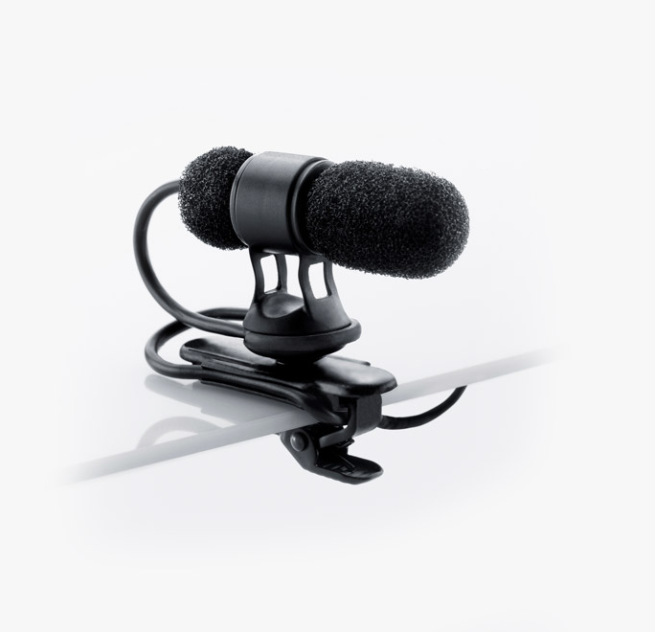
NAME
PIN MICROPHONE
MODEL
4080
제조사
DPA
Miniature Cardioid Microphone
Directional pattern : Cardioid
Principle of operation : Pressure gradient
Cartridge type : Pre-polarized condenser
Frequency response : 20 Hz - 20 kHz
Effective frequency range, ±2 dB, at 25 cm (9.8 in) : 250 Hz - 17 kHz with typ. 4 dB soft boost at 4 - 6 kHz (-5 dB at 100 Hz)
Sensitivity, nominal, ±3 dB at 1 kHz : 20 mV/Pa; -34 dB re. 1 V/Pa
Equivalent noise level, A-weighted : Typ. 23 dB(A) re. 20 µPa (max. 26 dB(A))
Distortion, THD < 1% - CORE : 126 dB SPL RMS, 129 dB SPL peak
Dynamic range : Typ. 100 dB
Max. SPL, THD 10% : 134 dB SPL peak
Rated output impedance : 30 - 40 Ω
Connector : MicroDot, TA4F Mini-XLR, 3-pin LEMO, Mini-Jack
Color : Black
Weight : 15 g (0.5 oz) incl. Cable and MicroDot connector
Microphone diameter : 5.7 mm (0.22 in)
Microphone length : 30 mm (1.2 in)
Cable length : 1.2 m (3.9 ft)
Cable diameter : 1.6 mm (0.06 in)

