Slide 1
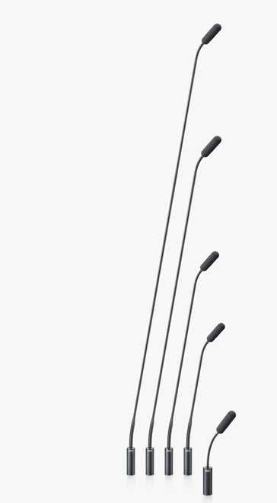
NAME
GOOSENECK MICROPHONE
MODEL
4098
제조사
DPA
Gooseneck Microphone
Directional pattern : Supercardioid
Principle of operation : Pressure gradient
Cartridge type : Pre-polarized condenser
Frequency response : 20 Hz - 20 kHz
Sensitivity, nominal, ±3 dB at 1 kHz : 16 mV/Pa; -36 dB re. 1 V/Pa
Distortion, THD < 1% - CORE : 130 dB SPL RMS, 133 dB SPL peak
Dynamic range - CORE : Typ. 110 dB
Max. SPL, THD 10% : 135 dB SPL peak
Rated output impedance
From MicroDot : 30 - 40 Ω.
From XLR connector or DAD6001-BC XLR Adapter : 100 Ω
Minimum load impedance : 2 kΩ
Connector : MicroDot or XLR-3M
Color : Black or white
Microphone diameter : 5.7 mm (0.22 in)
Microphone length
Microdot : 16 cm (6 in), 28 cm (11 in), 43 cm (17 in), 77 cm (30 in), 122 cm (48 in)
XLR-3M : 20 cm (8 in), 32 cm (13 in), 47 cm (18 in), 77 cm (30 in), 122 cm (48 in).

