Slide 1
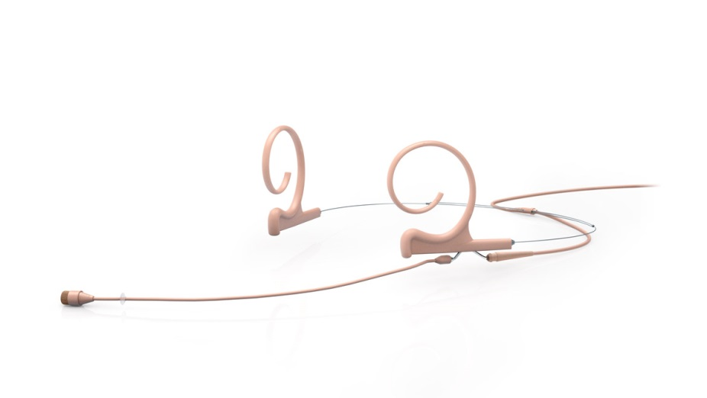
NAME
HEADSET MICROPHONE
MODEL
4266
제조사
DPA
Flex Omnidirectional Headset and Earset Microphone
Directional pattern : Omnidirectional
Principle of operation : Pressure
Cartridge type : Pre-polarized condenser
Frequency response : 20 Hz - 20 kHz
Effective frequency range ±2 dB
Soft boost grid : 40 Hz - 20 kHz, 3 dB soft boost at 8 – 20 kHz.
High boost grid : 40 Hz - 20 kHz, 10 dB boost at 12 kHz
Sensitivity, nominal, ±3 dB at 1 kHz : 6 mV/Pa; -44 dB re. 1 V/Pa
Distortion, THD < 1% - CORE : 134 dB SPL RMS, 137 dB SPL peak
Dynamic range - CORE : Typ. 111 dB
Max. SPL, THD 10% : 144 dB SPL peak
Rated output impedance : 30 - 40 Ω
Connector : MicroDot, TA4F Mini-XLR, 3-pin LEMO, Mini-Jack
Color : Black, beige or brown
Microphone diameter : 5.4 mm (0.21 in)
Microphone length : 12.7 mm (0.5 in)
Cable length : 1.3 m (4.3 ft)
Cable color : Black, beige or brown
Cable diameter : 1.6 mm (0.06 in)

