Slide 1
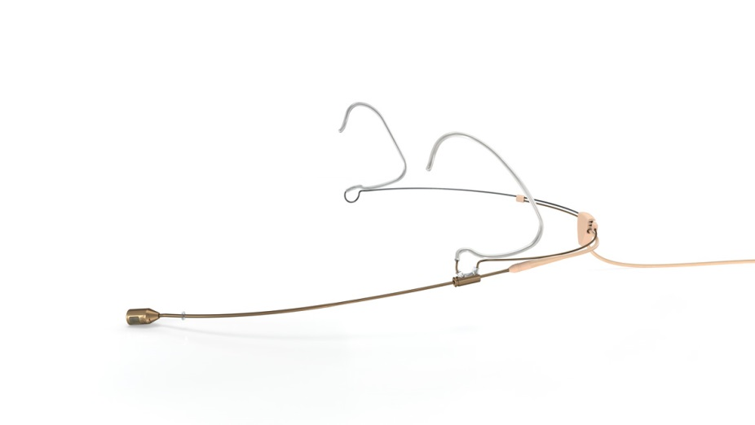
NAME
HEADSET MICROPHONE
MODEL
4488
제조사
DPA
Directional Headset Microphone
Directional pattern : Cardioid
Principle of operation : Pressure gradient
Cartridge type : Pre-polarized condenser
Frequency response : 20 Hz - 20 kHz
Effective frequency range, ±2 dB, Near field 2-3 cm (0.8 - 1.2 in) : 100 Hz - 20 kHz (4 - 6 dB soft boost at 15 kHz)
Sensitivity, nominal, ±3 dB at 1 kHz : 6 mV/Pa; -44 dB re. 1 V/Pa
Distortion, THD < 1% - CORE : 134 dB SPL RMS, 137 dB SPL peak
Dynamic range - CORE : Typ. 111 dB
Max. SPL, THD 10% : 144 dB SPL peak
Rated output impedance : 30 - 40 Ω
Connector : MicroDot, TA4F Mini-XLR, 3-pin LEMO, Mini-Jack
Color : Black, beige or brown
Weight : 14 g (0.5 oz) incl. Cable and MicroDot connector
Microphone diameter : 5.4 mm (0.21 in)
Microphone length : 11 mm (0.5 in)
Cable length : 1.2 m (3.9 ft)
Cable diameter : 1.6 mm (0.06 in)

