Slide 1
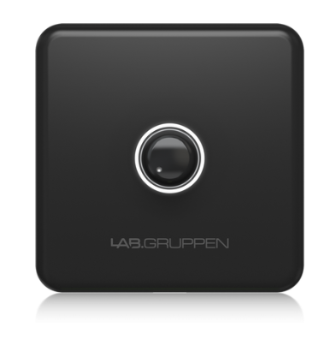
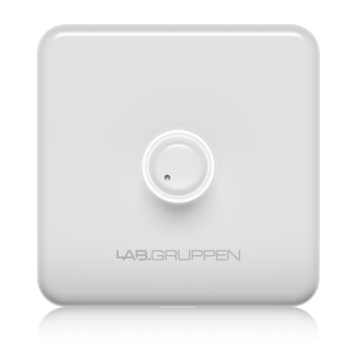
NAME
REMOTE CONTROLLER
MODEL
CRC-VEU
제조사
LAB.GRUPPEN
WALL MOUNT VOLUME CONTROLLER
Volume : 1 x rotary control
Connector : 1 x RJ45
Cable : Cat5/6
Cable length : Up to 305 m
Potentiometer : 20 kΩ linear
Dimensions (HxWxD) : 80 x 80 x 41 mm
Weight : 0.05 kg

