Slide 1
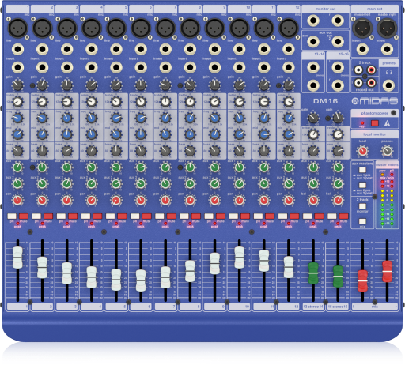
NAME
ANALOGUE MIXER
MODEL
DM16
제조사
MIDAS
16 Input Analogue Live and Studio Mixer
with MIDAS Microphone Preamplifiers
Mono Inputs : 12 x XLR, balanced
Line Input : 1/4" TRS, balanced
Stereo Inputs : 4 x 1/4 TRS connector, balanced
Equalizer
- Low : ±15dB @ 80Hz, shelving
- Mid(mono inputs only) : ±15dB @ 150Hz to 3.5kHz, variable semi-parametric
- High : ±15dB @ 12kHz, shelving
Channel Inserts : 1/4" TRS connector, unbalanced
Aux Sends : 2 x 1/4" TRS connector, balanced
Monitor Out : 2 x 1/4" TRS connector, balanced
Main Out : 2 x XLR, electronically balanced
Main Out Inserts : 2 x 1/4" TRS connector, unbalanced
Phones Output : 1/4" TRS connector, unbalanced
2-Track Inputs : 2 x RCA, unbalanced
Record Out : 2 x RCA, unbalanced
Switch mode power supply : 100~240V, 50/60Hz, switchable(T1.6A H250V)
Power consumption : 40w
Dimensions : W 438 x H 95 x D 370mm
Weight : 5 kg

